Slide 1
Simulating a Gray Code Counter in QSpice with a verilog module
By: EconomIC Engineers

Slide 2
Whats Gray Code
Gray code is a form a binary that increments one number to the next only by allowing one bit to change at a time.
What are the uses?
One bit change per transition reduces error and allows for better error checking.
In some cases, it is used to simplify logical operations

Slide 3
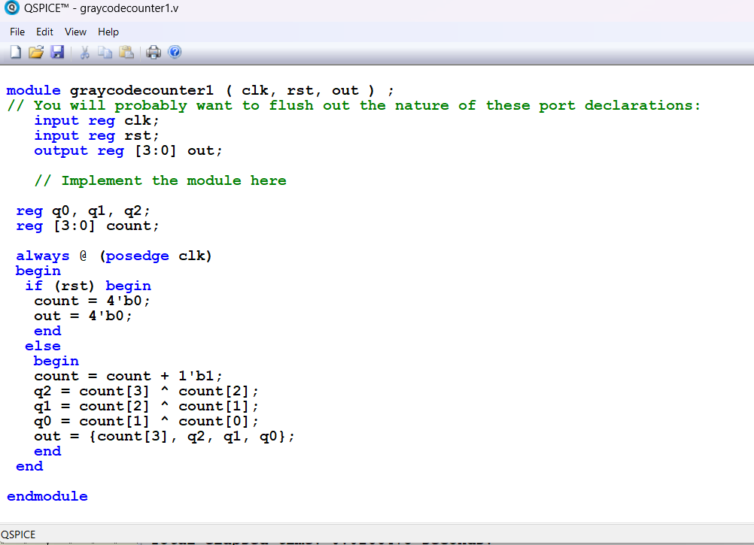
Verilog Code

Slide 4
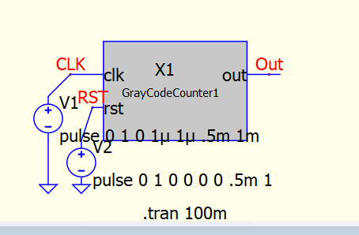
QSpice Circuit

Slide 5
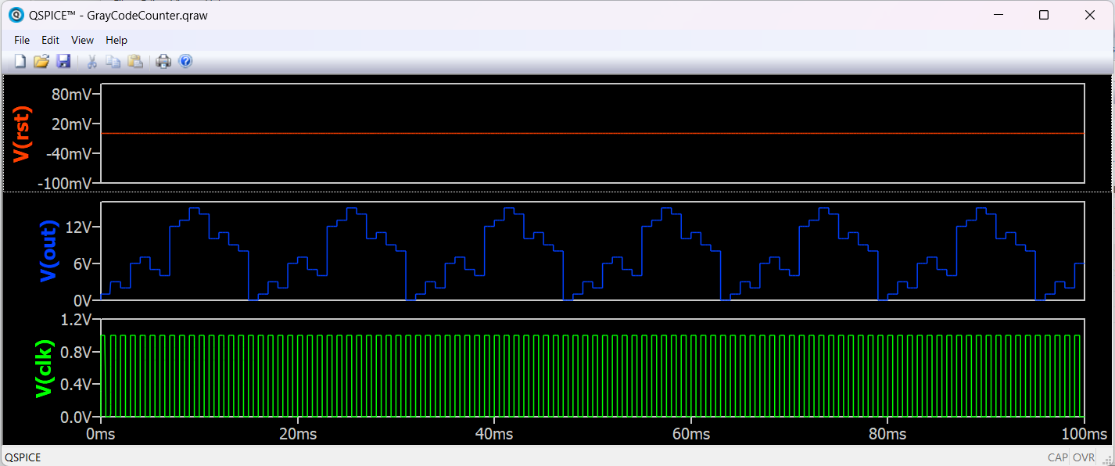
Simulation Results

Slide 6
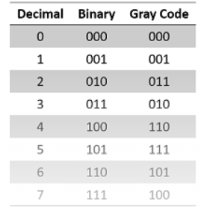
Gray Code
Conversion Table
Normal Decimal | Binary | Gray Code Conversion | Decimal After Gray code conversion
0 | 0000 | 0000 | 0
1 | 0001 | 0001 | 1
2 | 0010 | 0011 | 3
3 | 0011 | 0010 | 2
4 | 0100 | 0110 | 6
5 | 0101 | 0111 | 7
6 | 0110 | 0101 | 5
7 | 0111 | 0100 | 4
8 | 1000 | 1100 | 12
9 | 1001 | 1101 | 13
10 | 1010 | 1111 | 15
11 | 1011 | 1110 | 14
12 | 1100 | 1010 | 10
13 | 1101 | 1011 | 11
14 | 1110 | 1001 | 9
15 | 1111 | 1000 | 8

Slide 7
Expected Results
to Actual Results
Expected Results | From QSpice Sim
0 | 0
1 | 1
3 | 3
2 | 2
6 | 6
7 | 7
5 | 5
4 | 4
12 | 12
13 | 13
15 | 15
14 | 14
10 | 10
11 | 11
9 | 9
8 | 8

Slide 8
Sources
Gray Code as a Non-Arithmetic Coding System:
https://study.com/academy/lesson/gray-code-as-a-non-arithmetic-coding-system.html

